Slide 1

Module 2
Multi-Label Classification
Notes:
Guidelines
Use section headers to chunk content in your presentation.
Use the same style of section header throughout your presentation.
Keep your title to no more than 2 lines.

Slide 2
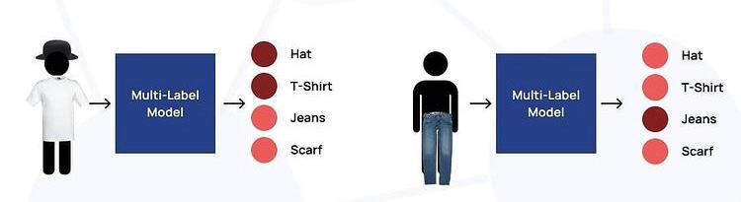
Multi-Label Classification
Notes:
Guidelines
Use a title slide at the beginning of your presentation. There are 9 variations of title slides to choose from.
If you will have a series of slideshows, we recommend using the same style of title slide for each presentation.
Keep your title to no more than 2 lines.
Do not change the font style or font size of the title or subtitle.

Slide 3
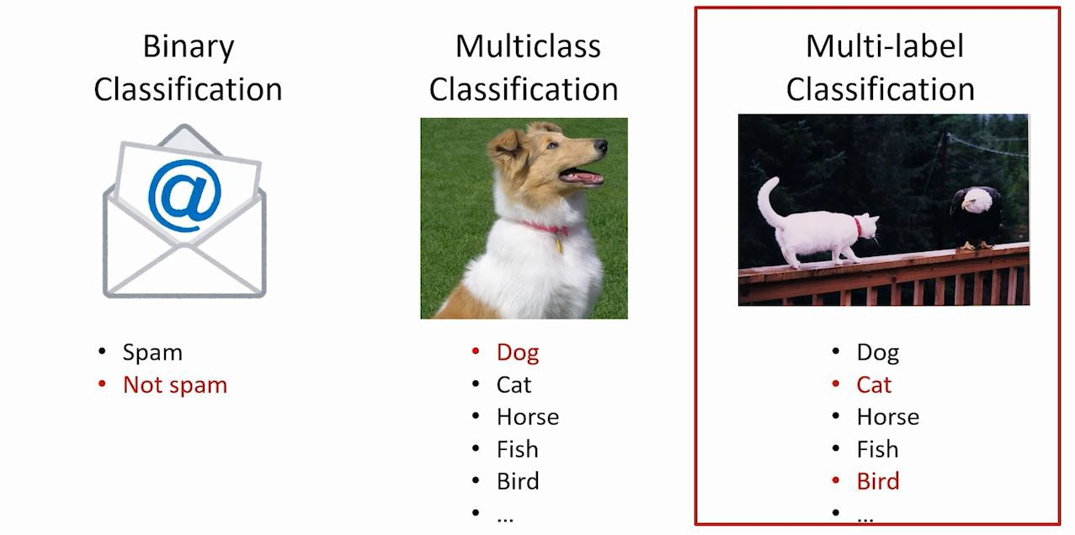
Types of Classification Problems
The 3 main classification problems are:

Slide 4
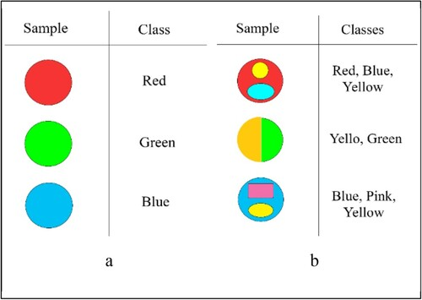
Multi-Label Classification
is the supervised learning problem where an instance may be associated with multiple labels

Slide 5
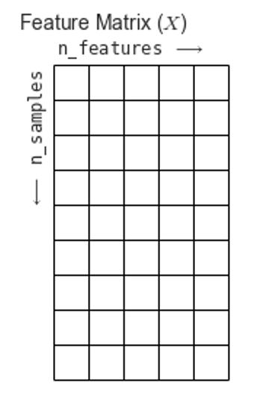
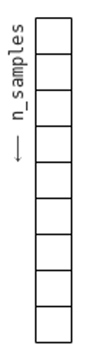
Multi-Label Classification
0
1
1
0
0
1
1
0
0
0
1
0
1
0
1
0
1
0
1
0
0
1
1
1
0
0
0
Response matrix

Slide 6
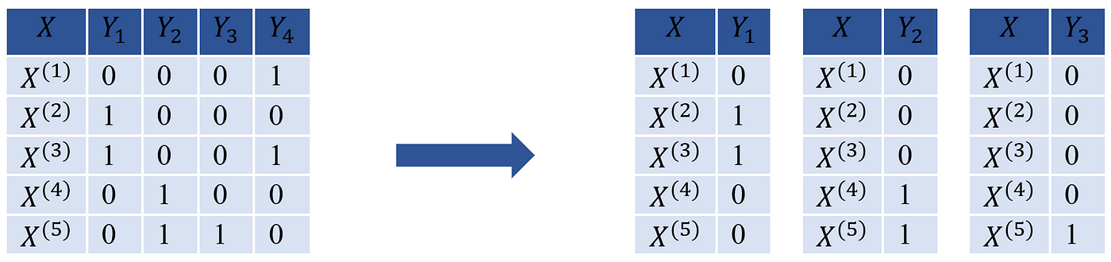
Binary Relevance
Decomposes learning tasks into independent binary problems.
Returns a propensity/prediction vector for each response
We fit each response independently

Slide 7
Fitting Each Response Independently
X
y
0
1
1
0
0
1
1
0
0
0
1
0
1
0
1
0
1
0
1
0
0
1
1
1
0
0
0
Response matrix

Slide 8
Fitting Each Response Independently
X
y
0
1
1
0
0
1
1
0
0
0
1
0
1
0
1
0
1
0
1
0
0
1
1
1
0
0
0
Response matrix

Slide 9
Fitting Each Response Independently
X
y
0
1
1
0
0
1
1
0
0
0
1
0
1
0
1
0
1
0
1
0
0
1
1
1
0
0
0
Response matrix

Slide 10
Python
Notes:
Guidelines
Use a title slide at the beginning of your presentation. There are 9 variations of title slides to choose from.
If you will have a series of slideshows, we recommend using the same style of title slide for each presentation.
Keep your title to no more than 2 lines.
Do not change the font style or font size of the title or subtitle.

Slide 11
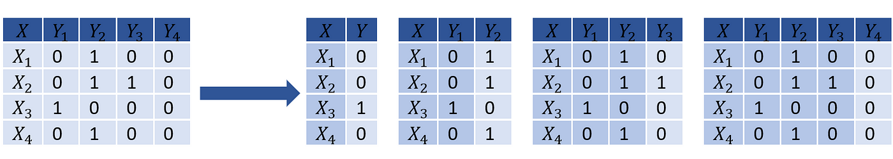
Classifier Chains
Arrange binary classifiers into a chain adding response vector to features.

Slide 12
Multi-Label Classification
0
1
1
0
0
1
1
0
0
0
1
0
1
0
1
0
1
0
1
0
0
1
1
1
0
0
0
Response matrix

Slide 13
Creating a Chain
y
0
1
1
0
0
1
1
0
0
0
1
0
1
0
1
0
1
0
1
0
0
1
1
1
0
0
0
X

Slide 14

Creating a Chain
y
$$y_{1}$$
0
1
1
0
0
1
1
0
0
0
1
0
1
0
1
0
1
0
1
0
0
1
1
1
0
0
0
X

Slide 15
Python
Notes:
Guidelines
Use a title slide at the beginning of your presentation. There are 9 variations of title slides to choose from.
If you will have a series of slideshows, we recommend using the same style of title slide for each presentation.
Keep your title to no more than 2 lines.
Do not change the font style or font size of the title or subtitle.

Slide 16
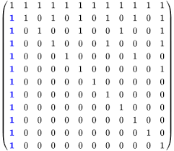
Metrics: Exact Match Ratio
Predictions that are exact matches to the response vectors are considered accurate
Partial matches are considered errors

Slide 17
Python
Notes:
Guidelines
Use a title slide at the beginning of your presentation. There are 9 variations of title slides to choose from.
If you will have a series of slideshows, we recommend using the same style of title slide for each presentation.
Keep your title to no more than 2 lines.
Do not change the font style or font size of the title or subtitle.

